Slide 1



Get Ready For
ICM LA
Let’s Learn
and
Explore!

Slide 2


Friday 20th May 2022
After Asr Salah @ 7pm
:
Dr. Ahsan Zafar
Refreshments to Follow
999 Reading Road, Mason, OH, 45040

Slide 3



Slide 4

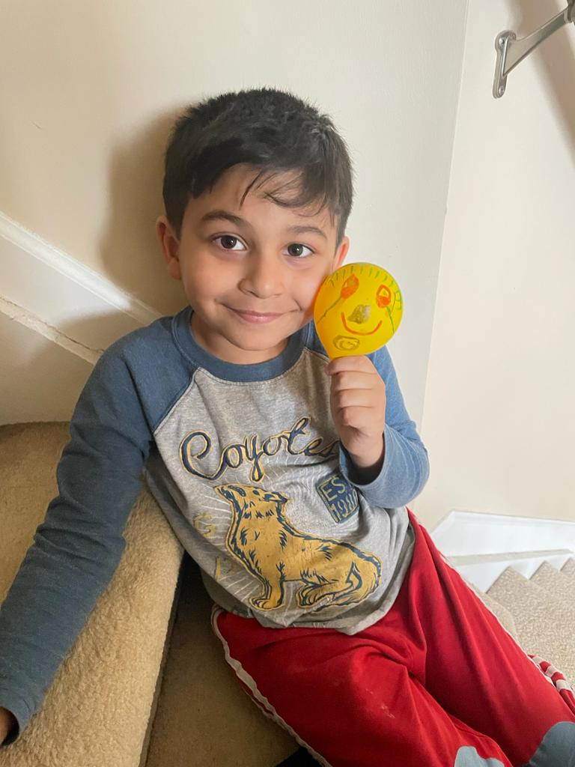
I want to be a Doctor and a Astronaut
Mohammed Hamza

Slide 5

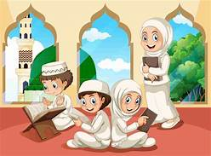



Get Ready For
ICM LA
KIDS SUMMER CAMP 2022
JUNE 6 – JULY 28 (8 weeks)
MONDAY – THURSDAY ‘ 9:30AM – 1:30PM
Duas / Prayers
Quran Translation / Tafseer
Reading, Writing & Speaking
Basic Arabic Language
Salah / play Time
Islamic Etiquette & Manners(Tarbiyyah)
Cincinnati Zoo
W2W Soccer Games
The Web
Farm Activity
Camping / Hiking
Makino Park Mason
For Ages 8 and above
Fees : $300 / 4 Weeks OR $600 / 8 Weeks
Pricing includes all activities, field trips, Certificate of completion & end of the camp party
Registrations closes JUNE 3
REGISTER : https://forms.gle/gYey36egsRYmrA8w7

Slide 6


IN THE NAME OF ALLAH, THE MOST GRACIOUS, THE MOST MERCIFUL
This is to Certify that سعادت زيبا بنت فضل احمد بن نذير احمد بن فضل على
(Sadath Zeba bint Fazal Ahmed bin Nazeer Ahmed bin Fazal Ali)
has obtained an Ijazah (authorisation) in the Holy Quran from Mujeeza Hafiza Dr. Magda Mohamed Kamel, Islamic Center of Mason Learning Academy on May 15th, 2022.
The Holy Quran Authorisation is in the narration of Imam Hafs and Imam Shu’ba’ from Imam Asim Abi An-Najood in the way of Shaatibiyyah.
Sr. Anila Zindani
Dr. Magda Mohamed Kamel
Program Director ICM LA
Certified Muajizah from
The Ratil Center, Egypt

Slide 7
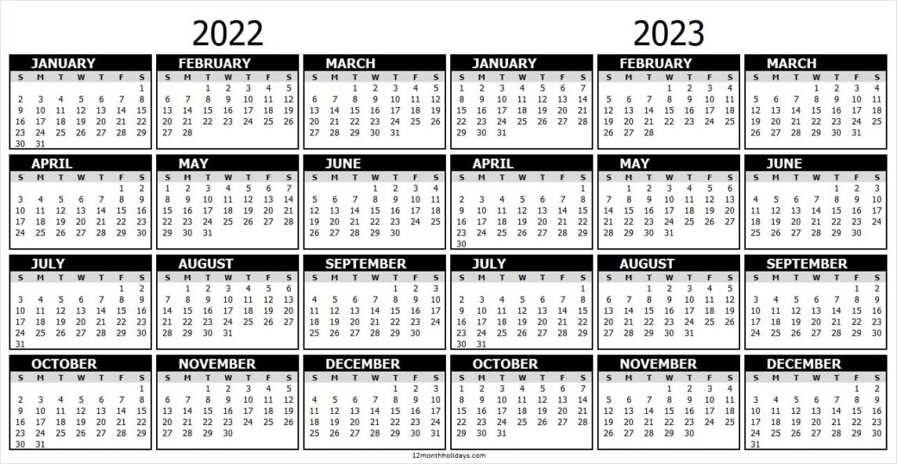

ICM Learning Academy

Slide 8
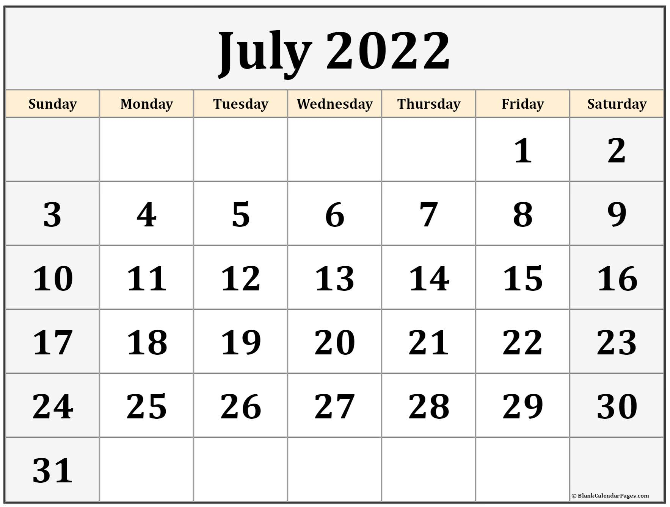
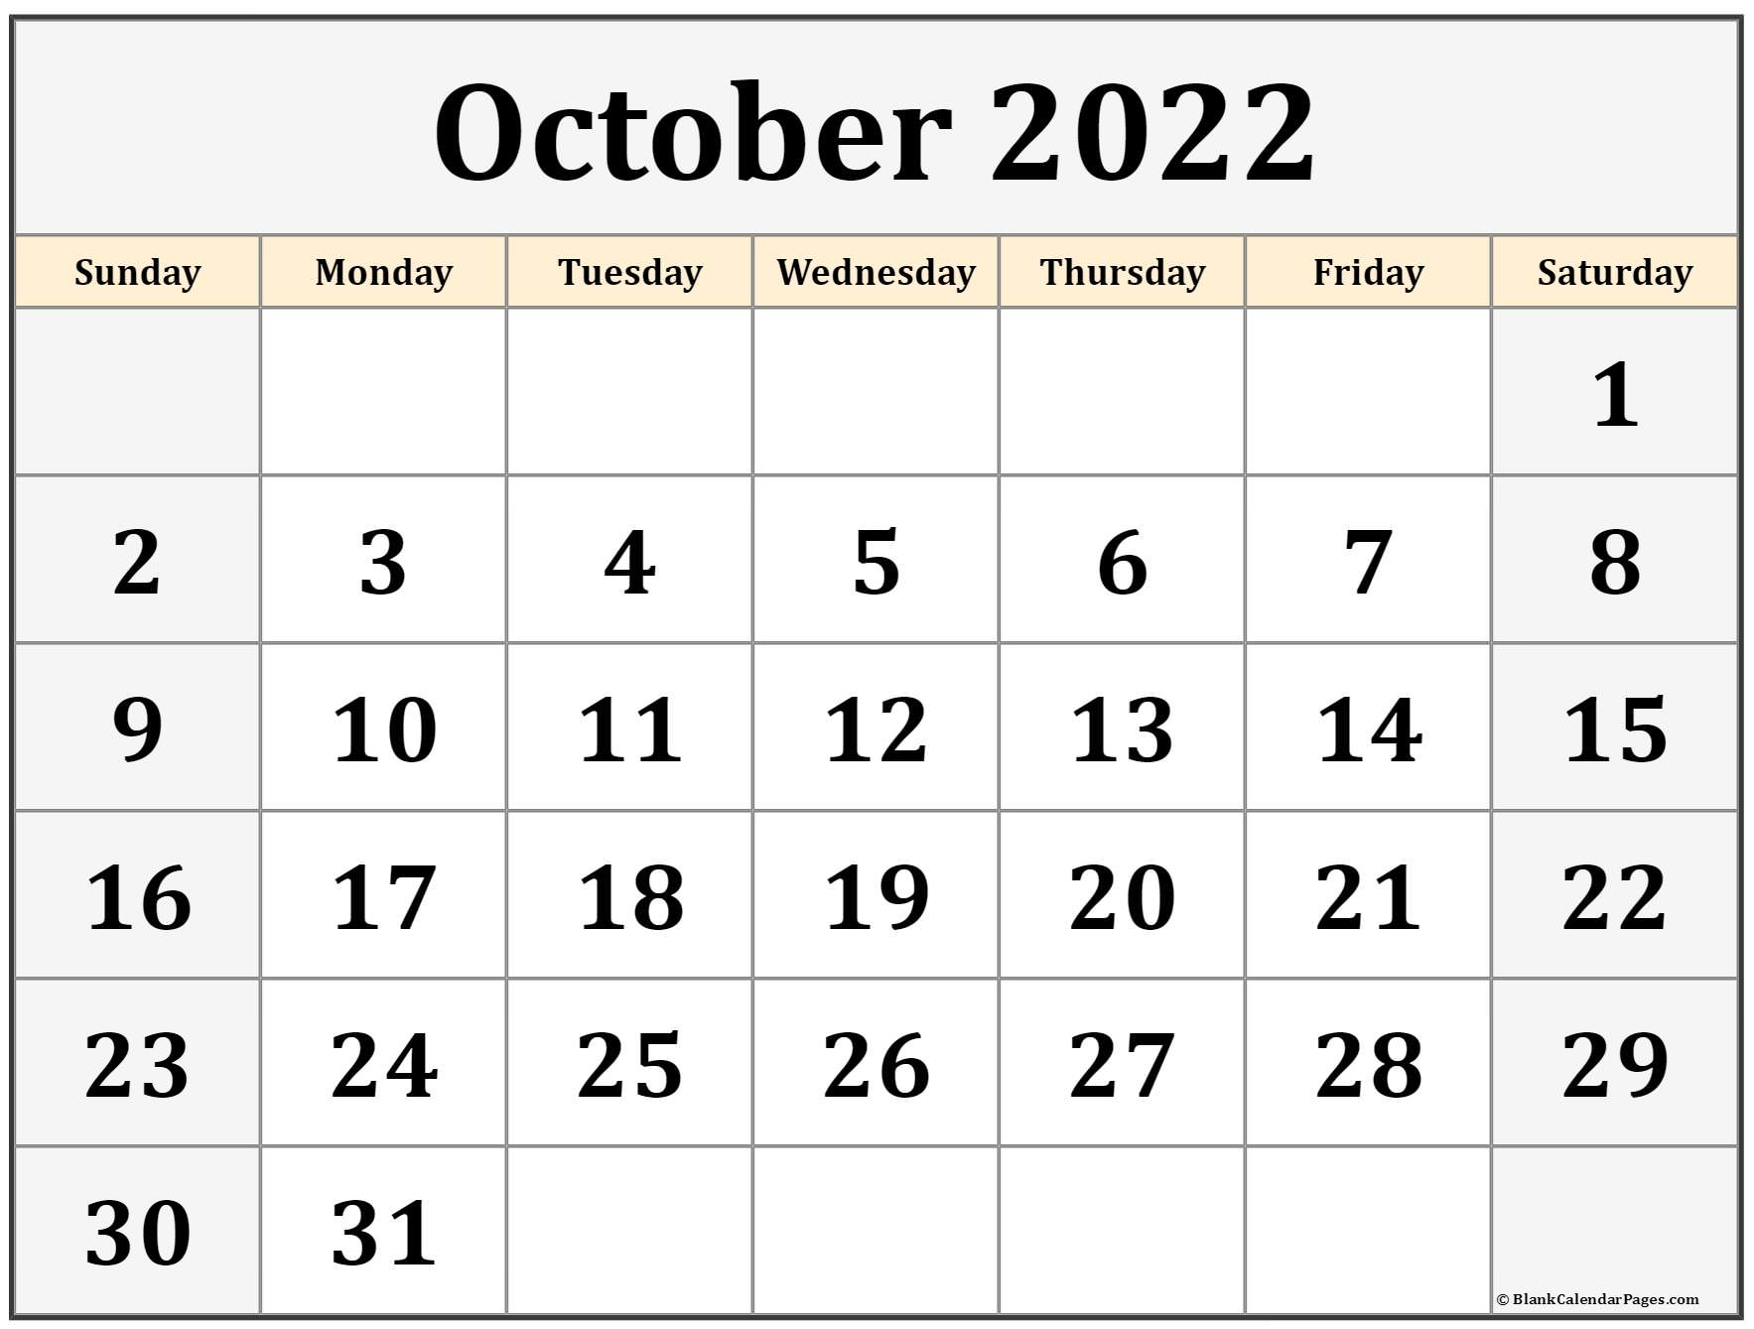
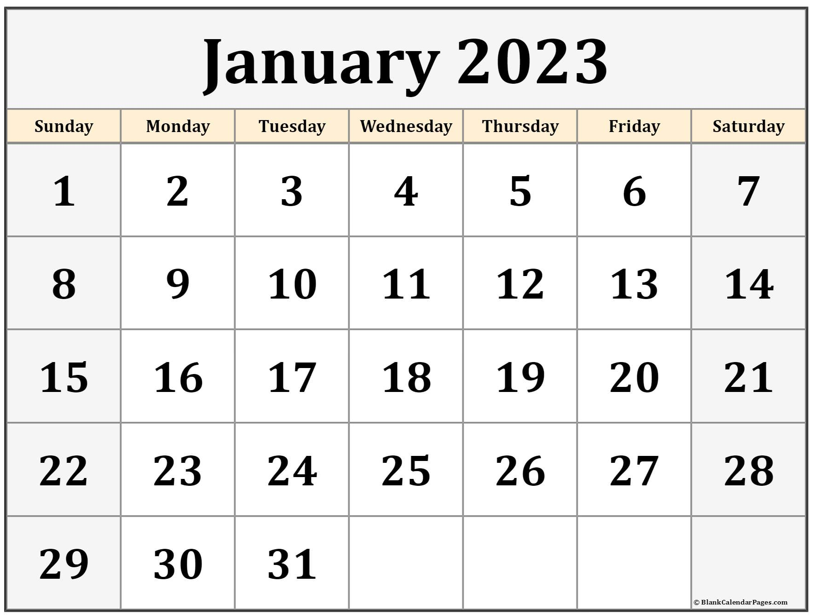
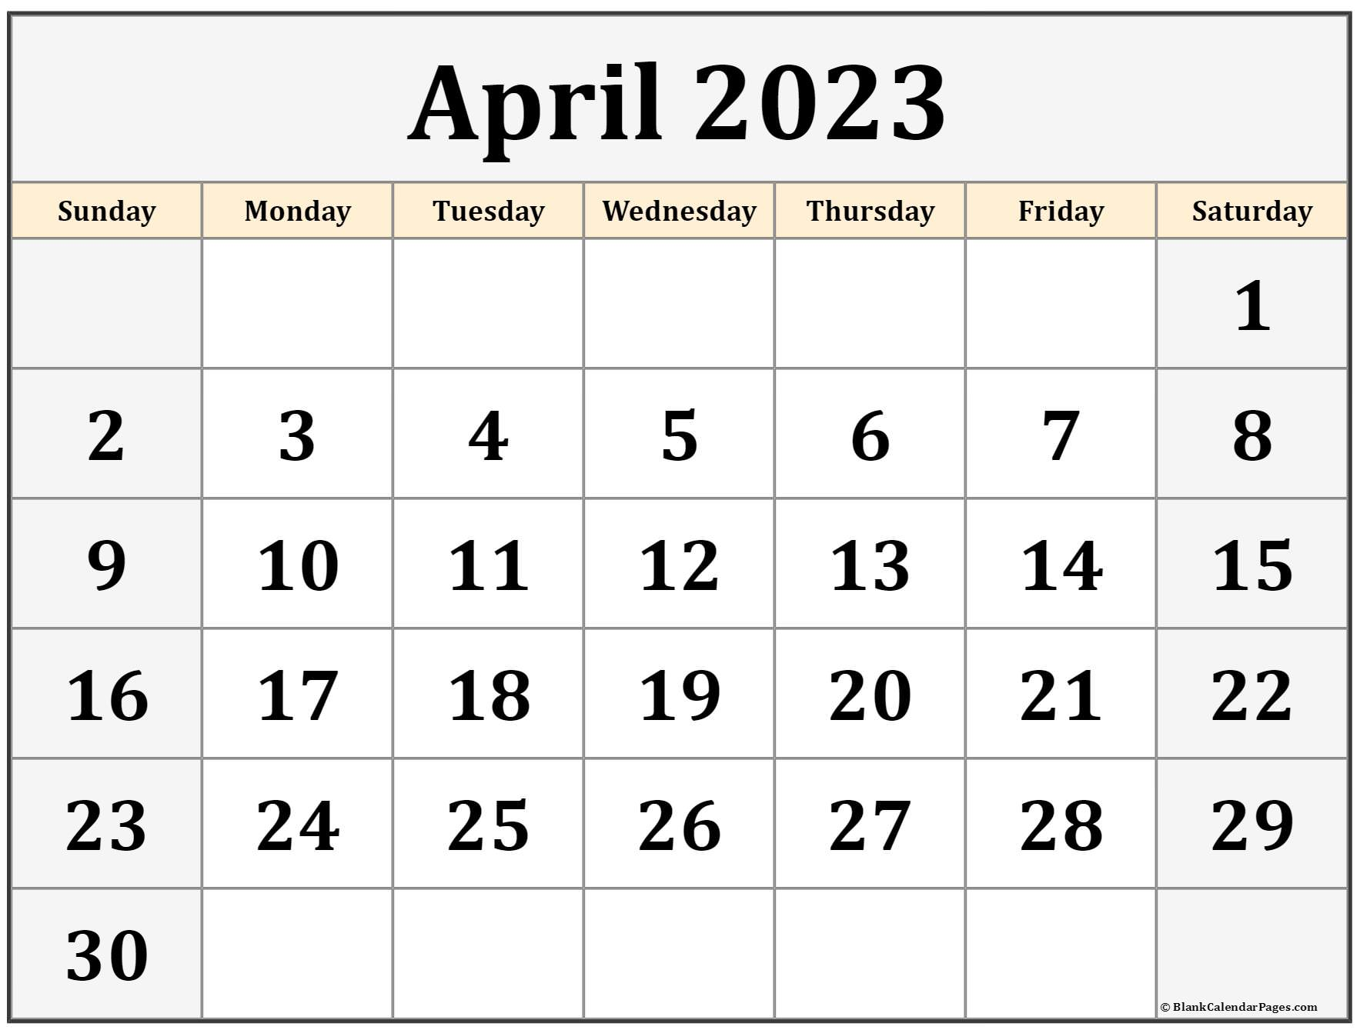



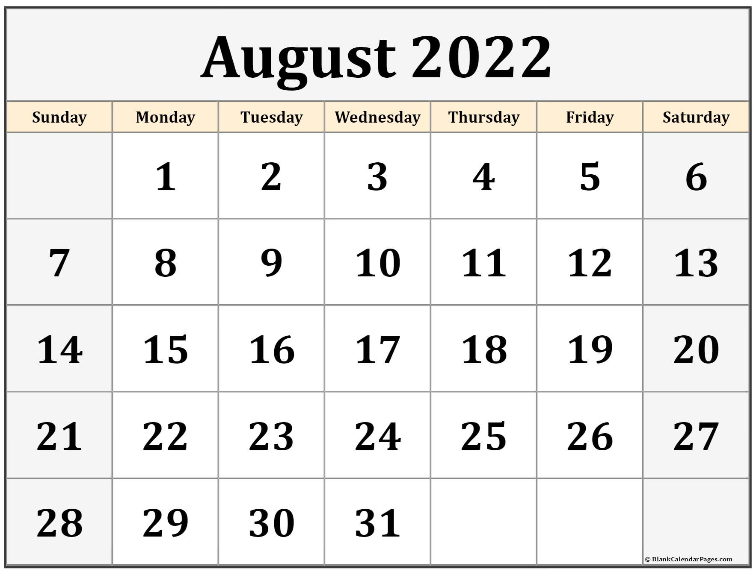
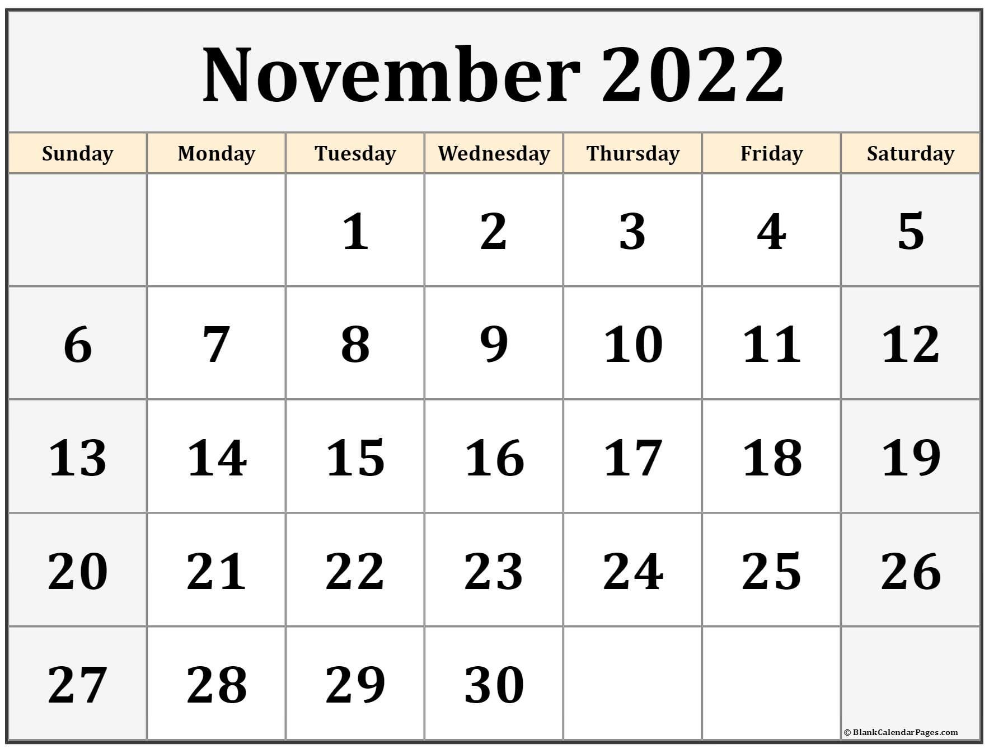
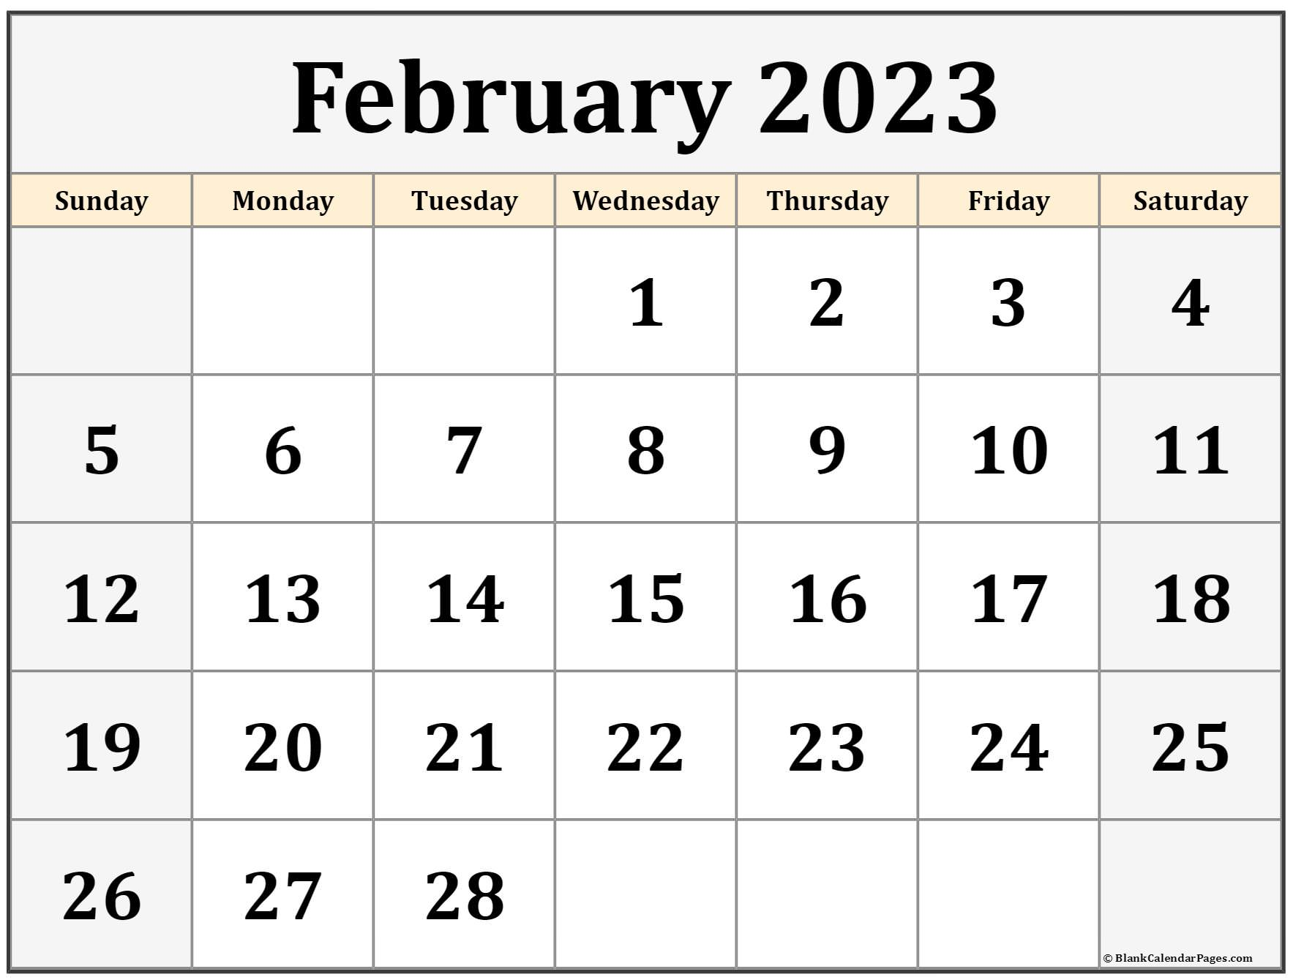
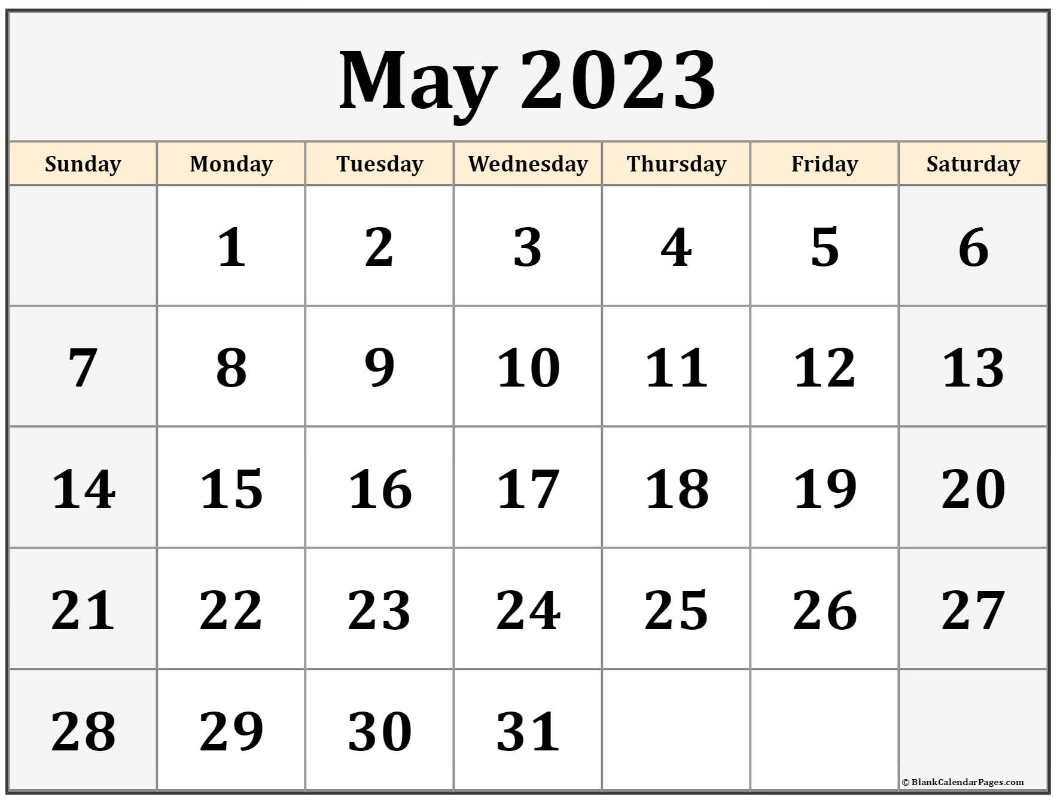



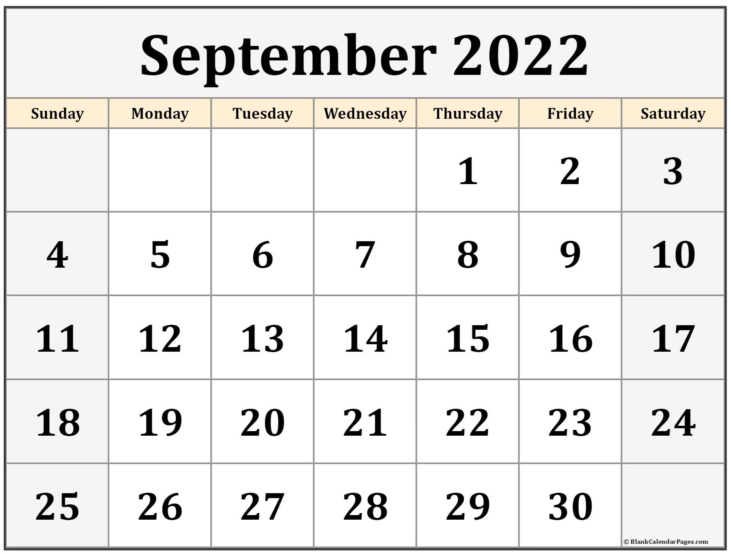
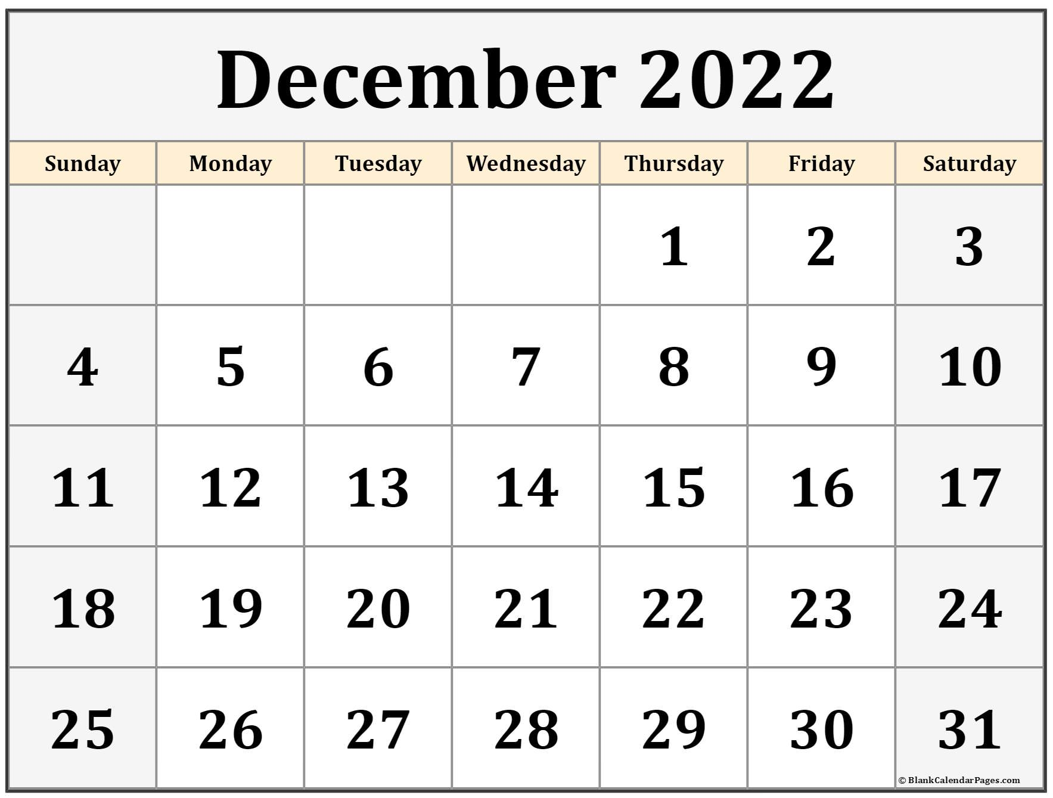
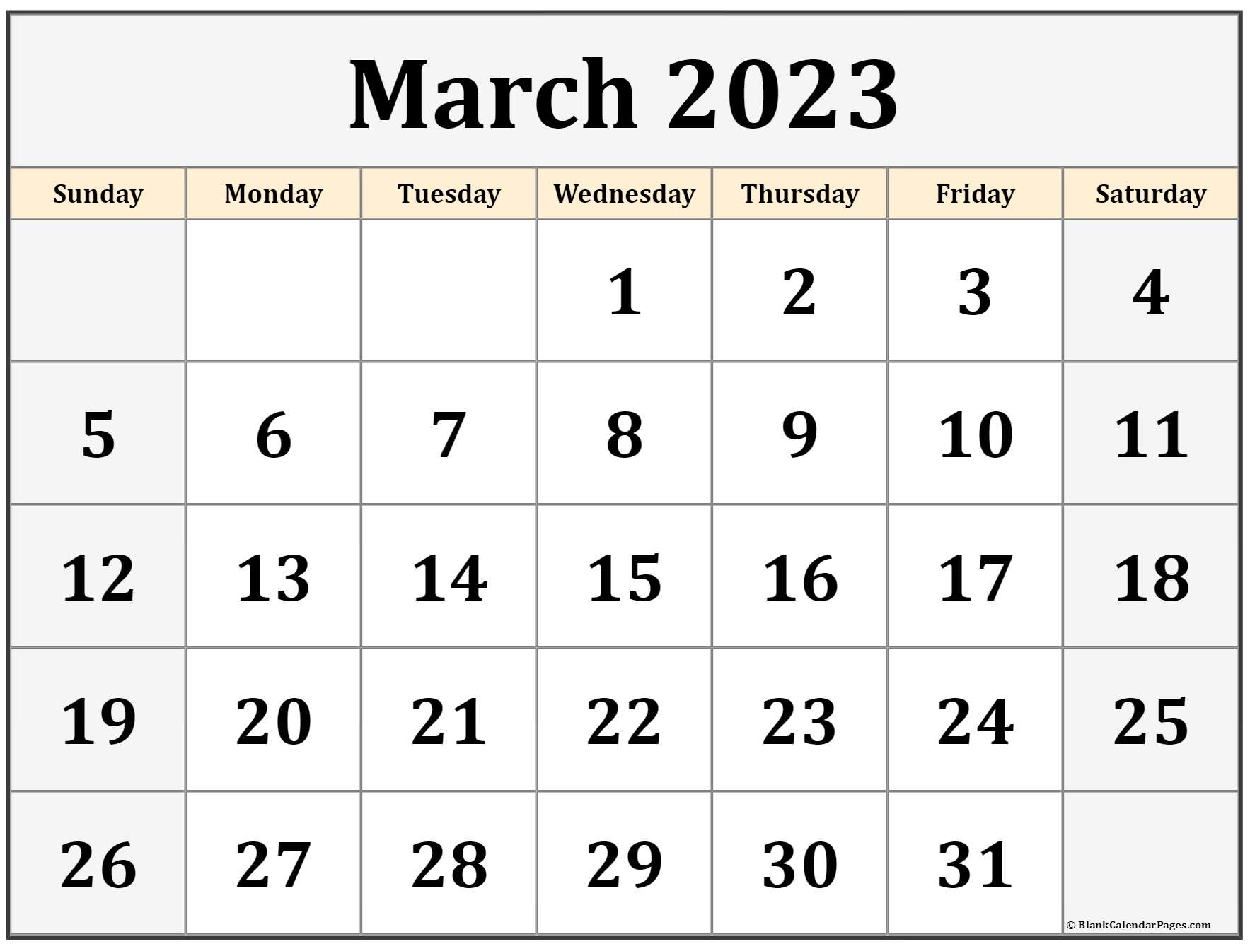
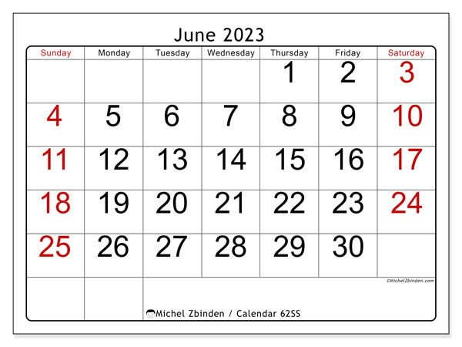


2022 -
- 2023
ICM LEARNING ACADEMY CALENDAR
July 17 – Eid Picnic Fun Day
Aug 20 – First Day of Saturday School
Sep 5 – Labor Day
Nov 21 –Nov 27 – Fall Break
Dec 10/11 – Parents Teacher Meetings
Dec 17/18 – Teachers & Board Meetings
Dec 24 – Jan 1 – Winter Break
Mar 25 – Mar 31 – Spring Break
Mar 26 – ICM LA Fundraiser
Apr 30 – Eid Fun Day
May 20 – Last Day of Saturday School
May 27 – Graduation Day
PLEASE NOTE : All ICM Learning Academy Calendar 2022-2023 dates are subject to change due to any unforeseen situations and Inclement weather. Ramadan and Eid dates are subject to change according to moon sighting.

Slide 9
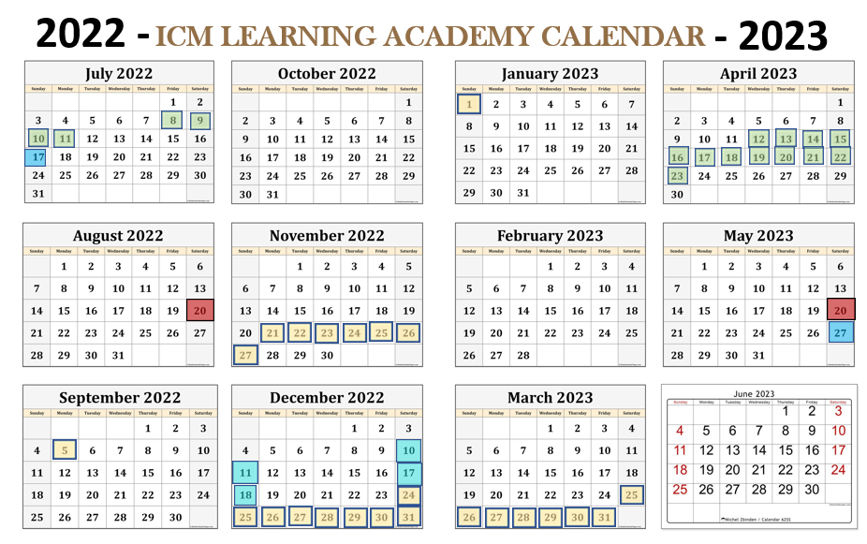

Slide 10
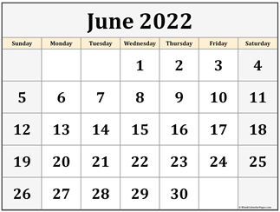

Slide 11

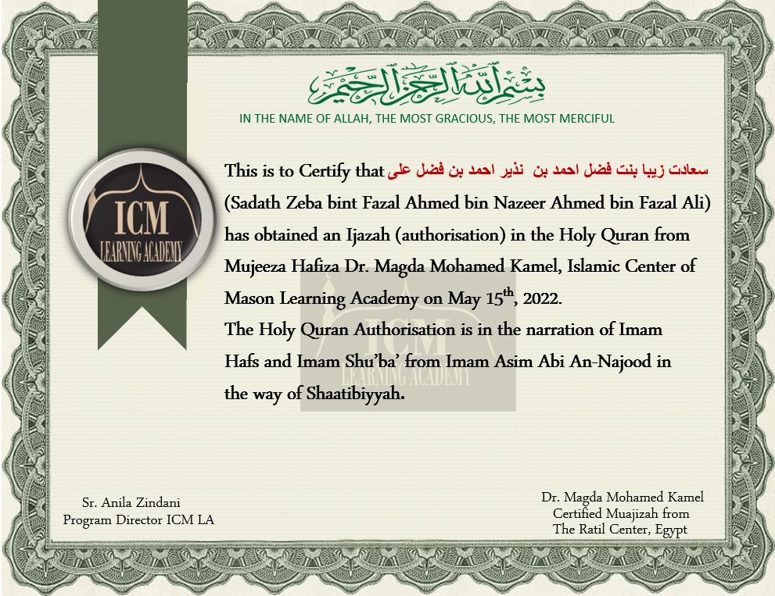
Ijazah
in
Quran Recitation with Tajweed

Slide 12


Slide 13
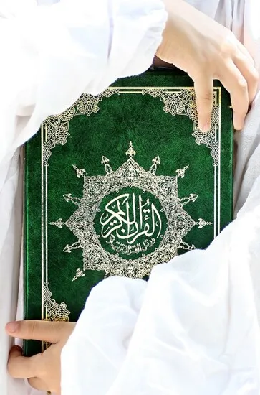
ICM LEARNING ACADEMY’S
SUMMER HIFZ PROGRAM
For Boys and Girls ages 7 and above
Program Starts
JUNE 6TH 2022
Monday – Thursday ; 9am – 2pm
Fee : $400 / Month
Register : https://forms.gle/tp5M6K9LoSYnG5729
108 Willaim St, Mason, OH, 45040

Slide 14
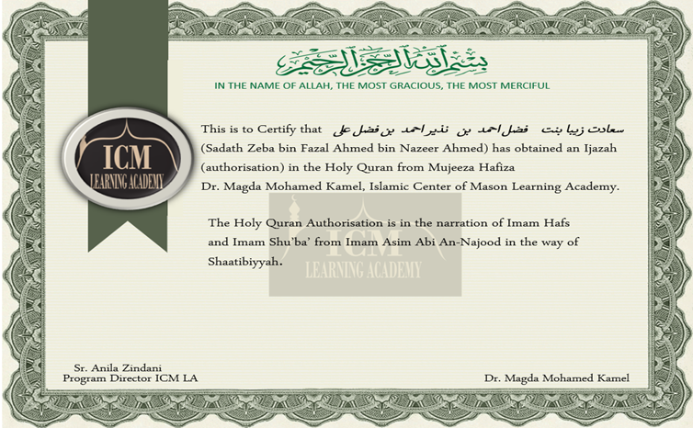

Slide 15


Slide 16



of
ICM LA WEEKEND SCHOOL
and
IJAZA COMPLETION CEREMONY WITH DUA
SUNDAY, MAY 15TH, 2022
11AM to 2PM
at
999 Reading Road, Mason, OH, 45040

